Slide 1
Compiler Design
SSWTZC373

Slide 2
Contact Session - 2
Introduction to Lexical Analyzer

Slide 3
Lexical Analyzer (A.k.a. Scanner)
The only part of a compiler that looks at each character of the source text and does a linear analysis
Reads source text and produces
Also keeps track of the source-coordinates of each token - which file name, line number and position
  (This is useful for debugging & error indication purposes.)
Advantages of a separate Lexical Analyzer:
  Keeps Compiler design simple
  Improves Efficiency and
  Increases Portability
TOKENS

Slide 4

The Role of a Lexical Analyzer
Lexical analyzer
next char
next token
Syntax
analyzer
get next
token
get next
char
Source
Program
symbol
table
(Contains a record
for each identifier)

Slide 5
Some terminologies:
  Token: a group of characters having a collective meaning. A lexeme is a particular instant of a token.
    E.g. token: identifier, lexeme: pi, etc.
  pattern: the rule describing how a token can be formed.
    E.g: identifier: ([a-z]|[A-Z]) ([a-z]|[A-Z]|[0-9])*
Lexical analyzer does not have to be an individual phase. But having a separate phase simplifies the design and improves the efficiency and portability.

Slide 6
Tokens, Patterns and Lexemes
What are Tokens ?
  The basic lexical units of the language
  A sequence of Abstract Characters that can be treated as a
  unit in the grammar of the language
  A programming language classifies the tokens into a finite set of token types
A note on Terminology
Some texts refer to
  token types as tokens &
  tokens as lexeme
  We will stick to the terms
  Tokens and Token Types
Some tokens may have attributes
  integer constant token will have the actual integer (17, 42) as an attribute;
  Identifiers will have a string with the actual id

Slide 7
Tokens Example
Let us Consider the program segment:
  void main() { printf("Hello World\n"); }
The tokens of this program segment are:
    void,
    main,
    (,
    ),
    {
    printf,
    (,
    "Hello World\n",
    ),
    ; and
    }

Slide 8
Specifications of Tokens
String Words and Sentences
Prefix of s A string obtained by deleting trailing symbols
suffix of s A string obtained by deleting leading symbols
Substring of s A string obtained by deleting a prefix & a suffix
Proper A prefix, suffix or sub string that is nonempty s.t s = x
Subsequence of s A string obtained by deleting symbols not necessarily contiguous

Slide 9
The Principle of Longest match
In most languages, the scanner should pick the longest
possible string to make up the next token if there is a choice
Example
    return foobar != hohum;
  should be recognized as 5 tokens
  not more (i.e., not parts of words or identifiers, or ! and = as separate tokens
RETURN
ID(foobar)0
NEQ
ID(hohum)
SCOLON

Slide 10
Typical Tokens in Programming Languages
Operators & Punctuation
  + - * / ( ) { } [ ] ; : :: < <= == = != ! …
  Each of these is a distinct lexical class ( or token type )
Keywords
  if while for goto return switch void …
  Each of these is also a distinct lexical class (not a string)
Identifiers
  A single ID lexical class, but parameterized by actual id
Integer constants
  A single INT lexical class, but parameterized by int value
Other constants, etc.

Slide 11
Tokens of a Typical Language
TYPE
EXAMPLE
ID
foo, n14, a, temp……
NUM
73 , 0 , 00 , 515 , +2 ……..
REAL
66.1 .5 10. 1e67 5.5e-10 ……..
KEYWORDS
IF DO WHILE INT ………
SYMBOLS
, (Comma) != (Noteq) ( (Lparen) …….

Slide 12
Tokens of a Typical Language
TYPE
EXAMPLE
ID
foo, n14, a, temp……
Question: How are tokens formally defined and recognized?
Answer: By using regular expressions to define a token as
a formal regular language
NUM
73 , 0 , 00 , 515 , +2 ……..
REAL
66.1 .5 10. 1e67 5.5e-10 ……..
KEYWORDS
IF DO WHILE INT ………
SYMBOLS
, (Comma) != (Noteq) ( (Lparen) …….

Slide 13
Formal Definition of Languages
Alphabet
String
Language
A finite (non-empty) set of symbols denoted by Σ
A finite sequence of symbols from an alphabet which includes even the empty sequence (denoted by λ )
A set ( often infinite) of finite strings
The set of all possible finite strings of elements of alphabet Σ ( including λ ) is denoted by Σ*
Finite specifications of (possibly infinite) languages is possible with
  Automaton – a recognizer; a machine that accepts all strings in a language (and rejects all other strings)
  Grammar – a generator; a system for producing all strings in the language (and no other strings)

Slide 14
Formal Language Definition ( Contd. )
As already defined A language L over an alphabet Σ is a
collection of strings of elements of Σ
  The PASCAL Language is the set of all strings that
  constitute legal PASCAL programs (infinite set)
  The Language of primes is a set of all decimal digit strings that constitute prime numbers (infinite set)
  The language of C reserved words is the set of all
  alphabetic strings that can not be used as identifiers in the C programming language (finite set)
To specify some of these (possibly infinite) languages with
finite description we use the notation of
Regular Expressions

Slide 15
Regular Expressions
Is always defined over some alphabet Σ
(For programming languages, it is commonly ASCII or Unicode)
If E is a regular expression, L(E ) is the “language”
(set of strings) generated by E
For Example – For each symbol ‘a’ in the alphabet of the language the regular expression {a} denotes the language containing just the string a ( Known as symbol)
A regular expression generated with empty sequence λ is denoted by ε

Slide 16
Formal definition of Regular expression:f
    Given an alphabet ,
    (1) is a regular expression that denote { }, the set that contains the empty string.
    (2) For each , a is a regular expression denote {a},
    the set containing the string a.
    (3) r and s are regular expressions denoting the language
    (set) L(r ) and L(s ). Then
      ( r ) | ( s ) is a regular expression denoting L( r ) U L( s )
      ( r ) ( s ) is a regular expression denoting L( r ) L ( s )
      ( r )* is a regular expression denoting (L ( r )) *
    Regular expression is defined together with the language it denotes.

Slide 17
Examples
let
    a | b
    (a | b) (a | b)
    a *
    (a | b)*
    a | a*b
  We assume that ‘*’ has the highest precedence and is
  left associative. Concatenation has second highest
  precedence and is left associative and ‘|’ has the lowest
  precedence and is left associative
    (a) | ((b)*(c ) ) = a | b*c

Slide 18

Operations with Regular Expressions
Given 2 regular expressions M & N
Alternation ( denoted by | )
makes a new regular expression M | N denoting a
UNION” of languages L(M) and L(N). { L(M) L(N) }
Concatenation ( denoted by . Or )
makes a new regular expression MN denoting a language L(M) followed by L(N).
The Repetiton ( denoted y * )
makes a new expression denoting a language that
has 0 or more occurrences (Kleene closure) of L(M)*

Slide 19
Regular Expression Example
Expression Language Example Words
a | b { a, b } a , b
ab * a {a} {b} * {a) aa , aba , abba , abbba
(ab)* { ab} * ε , ab , abab , ababab , …
abba { abba } abba
(0 | 1) * 0 { {0} {1} } * {0} 0 , 00 , 10, 010, 110, ( All binary Even numbers)
b*(abb*)*(a | ε) Strings of a and b with NO consecutive a
Similarly, using symbols, | , . ,* and ε, we can specify the regular expressions corresponding to the lexical tokens of a programming language using rules ( A.k.a. Productions)

Slide 20
Table of Operators & Abbreviations
Notation
Description
a
An ordinary character that stands for itself
ε
The empty String
M | N
Alternation; Choosing from M OR N
MN
Concatenation : An M followed by N
M*
Repetition ( Zero or more Times)
M⁺
Repetition ( one or more times)
M?
Optional (Zero or one Occurrence of M)
[a–z A–z ]
Character set alteration
[abxyz]
One of the given characters (a|b|x|y|z)
.
Stands for a single character ( except New line)
‘a.⁺*’
Quotation: A string in quotes stands for itself literally

Slide 21
Problems
Design Regular expression for the following
Languages.
L = {w ϵ {a, b} * : every a in w is immediately
preceded and followed by b}.
2) L = {w ϵ {a, b} * : |w| is even}.
3) L = {w ϵ {0, 1} * : the third character is 0}.
4) L = {w ϵ {a, b} * :w contains an odd number of a’s}.

Slide 22
5) L = {w ϵ {0, 1} * atmost one pair consecutive
1’s}.
6) L = {w ϵ {a, b} * : more than two letters with beginning and ending same letters}.
7) L = {w ϵ {0, 1} * : every pair of adjacent 0’s appears before any pair of adjacent 1’s}.
8) L = {w ϵ {0, 1} * :length of w is odd }.

Slide 23
Solution
(b | bab)*
2) ((a | b) (a |b))* or (aa |ab |ba |bb)*
3) (0 |1) (0 |1) 0 (0 |1)*
4)b*(ab*ab*)* a b* or b*a b* (ab*ab*)*
5) (1 | 01)* 00 1*
6) a (a | b)* a | b (a |b)* b
7) (1 | 01 )* ( 0 | ϵ) (0 | 10)* (1 | ϵ)
8) (ab | ba |aa |bb)* (a | b)

Slide 24
Regular Expression Construction
Problem : Specify a set of unsigned numbers as a
regular expression. (Examples: 1997, 19.97)
Observations on numbers:
  Could be made up of one or more digits from set
  (0 – 9)
  2. Optionally Can have a decimal point in the end
  followed by 0 or more digits “.”(0 – 9)*
  3. A number can also start with a Point followed by one or
  more digits
[
(0 – 9)⁺
[“.”(0 – 9)*] ?
]
|
[“.”(0 – 9) ⁺]

Slide 25
Regular Expressions for Some Tokens of a Programming Language
Regular Expression
Token Type
if
[ Return IF; ]
[ a – z ] [ a – z 0 – 9 ]*
[ return ID ]
[ 0 – 9 ] ⁺
[ return NUM ]
( [0 – 9 ] + ‘ . ’[ 0 – 9 ] * ) | ( [ ‘ . ’[ 0 – 9 ] +)
Return REAL
(‘\*’ [ a – z ] * ‘\n’ ) | (‘ ’)| ‘\n’ | ‘*/’)⁺
return Comment
.
return ERROR

Slide 26
Regular definition.
  gives names to regular expressions to construct more
  complicate regular expressions.
      d1 -> r1
      d2 -> r2
      …
      dn ->rn
  example:
    letter -> A | B | C | … | Z | a | b | …. | z
    digit -> 0 | 1 | 2 | 3 | 4 | 5 | 6 | 7 | 8 | 9
    identifier -> letter (letter | digit) *

Slide 27
A regular Expression Recognizer
Given an input string,
The function of a “regular Expression Analyzer” is to say
  “YES, the input is part of the language
  generated from the regular expression”
  “NO, the input isn’t part of the language
  generated from the regular expression”
Using results from Finite Automata theory and theory of algorithms, we can automate construction of such recognizers from Regular Expressions

Slide 28
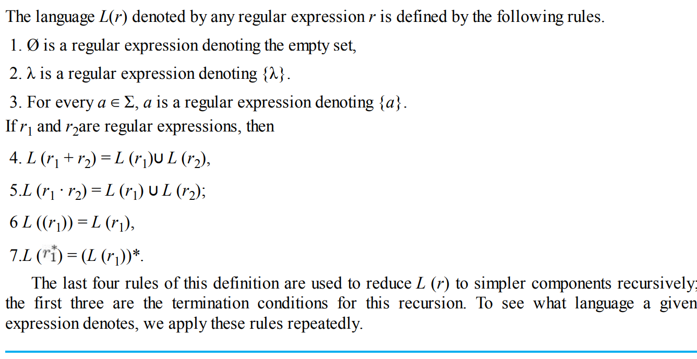
Languages Associated with
Regular Expressions

Slide 29
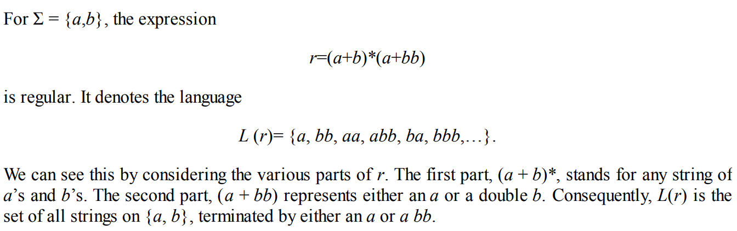
Example

Slide 30
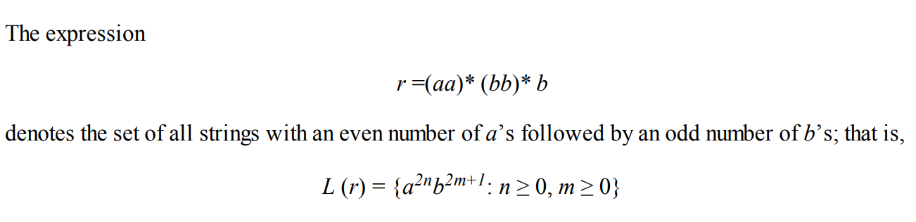
Example

Slide 31
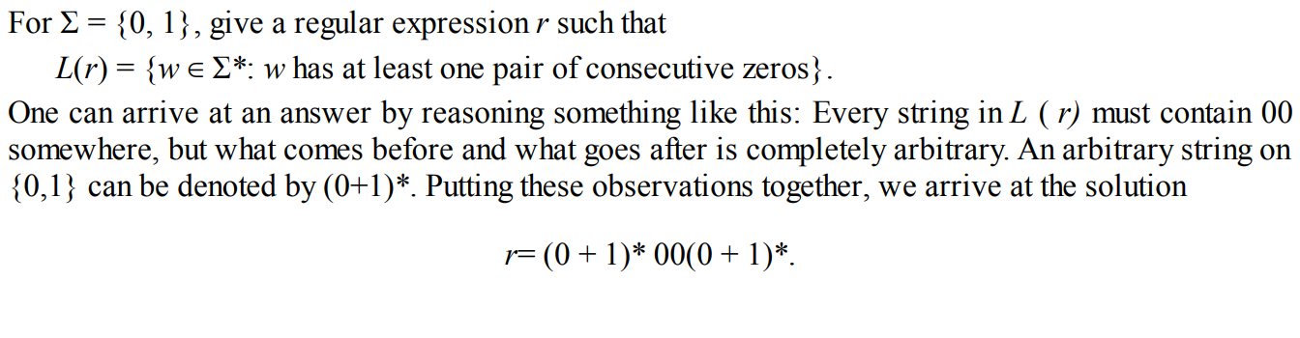
Example

Slide 32
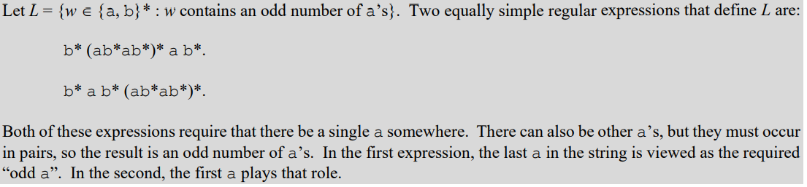
More than One Regular Expression for a Language

Slide 33
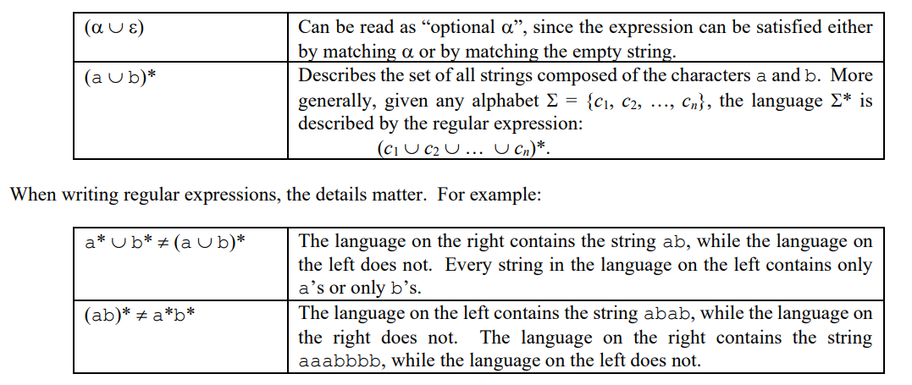
RegEx - idioms

Slide 34
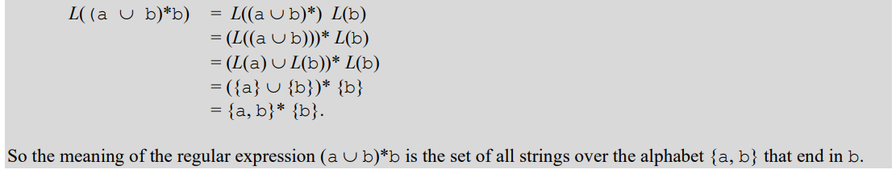
Analyzing a Simple Regular Expression

Slide 35
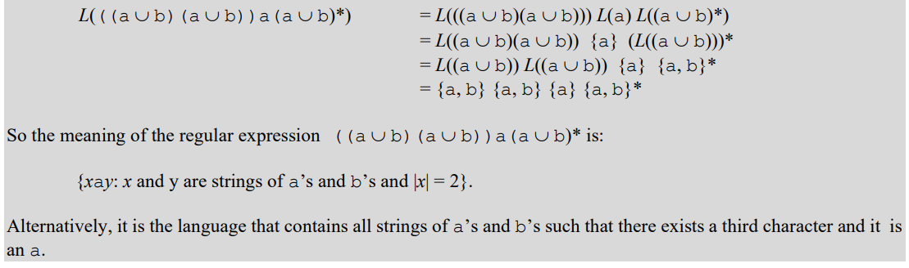
Another Simple Regular Expression

Slide 36
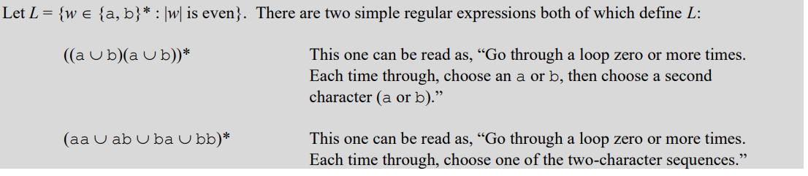
Given a Language, Find a Regular Expression

Slide 37
Regular Expressions
https://www.javatpoint.com/examples-of-regular-expression
https://www.w3schools.com/python/python_regex.asp

Slide 38
Thank you

